Slide 1
ProvidenceSMS(Student Management System)

Slide 2
CLIENT INFORMATION
Client : Julliard Academy
Established in 2013 and situated in Lagos, Nigeria. It is an International Secondary School approved by Lagos State Ministry Of Education and allocated for WAEC, NECO and BECE Examination Centers.
Julliard Academy is a co-educational day and boarding school offering grades 7 to 12 and preparing students for University Education.

Slide 3
Project business need
Saves Time and resources in maintaining the data of students and Faculty
Enhances Productivity and Avoids Manual Work..
Automates Entire Admission Process of Institutions ...
Improves Admission Ratio and Institute performance ...
Generate Fee Receipts and helps to send them with an attachment. ...
Tracks records of student in/out timing. ...
Manage Contacts with Ease. ...

Slide 4
Project Architecture
JULLIARD ACADEMY
ADMIN
TEACHER
PARENTS

Slide 5
Project Architecture - Admin
ADMIN
Dashboard
My Profile
Classroom
Grade
Subject
Subject Routing
Timetable
Student Payment
Teacher
Student
Attendance
Exam
Friends
Events
Petty Cash
Add Teacher
Add Student
Add Attendance
Create Exam
Add Friends
My Events
All Student
Exam Timetable
My Friends
All Events
All Teacher
Student Attendance History
Student Exam Marks
Leave Student
Teacher Attendance History
Student Exam Marks History

Slide 6
Project Architecture - Teacher
TEACHER
Dashboard
My Profile
Subject
My Student
Timetable
Events
Attendance
My Salary
Exam
Friends
My Petty Cash
My Subject
My Timetable
My Events
My Student Exam Marks
Add Friends
My Attendance
All Subject
All Timetable
All Events
My Friends
My Attendance History
My Student Exam Marks History
Exam Timetable
6

Slide 7
Project Architecture - Parents
PARENTS
Dashboard
Profile
Subject
Teacher
Timetable
Attendance
My Son’s Payments
Exam
My Profile
My Son’s Subject
My Son’s Teacher
My Son’s Timetable
My Son’s Exam Marks
My Son’s Attendance
My Son’s Profile
All Subject
All Timetable
All Teacher
My Son’s Attendance History
My Son’s Exam Marks History
My Son’s Exam Timetable

Slide 8
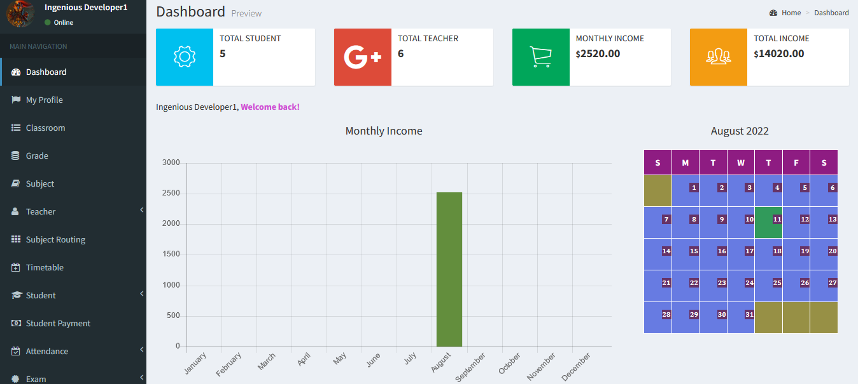
Project Module Explanation
1. DASHBOARD
It also helps us track the monthly income via graph.
Dashboard module helps us to monitor total number of students and teachers registered to the Organisation.
It also helps us to monitor the monthly income and the total income of the Organisation.
8

Slide 9
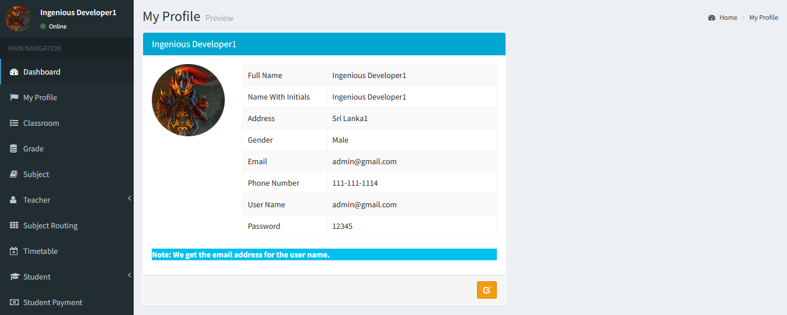
Project Module Explanation
2. MY PROFILE
My Profile module displays the profile of the User who has logged in.
It also enables the User who has logged in to update his/her profile.
It consists of the credentials in order to authenticate the User.

Slide 10
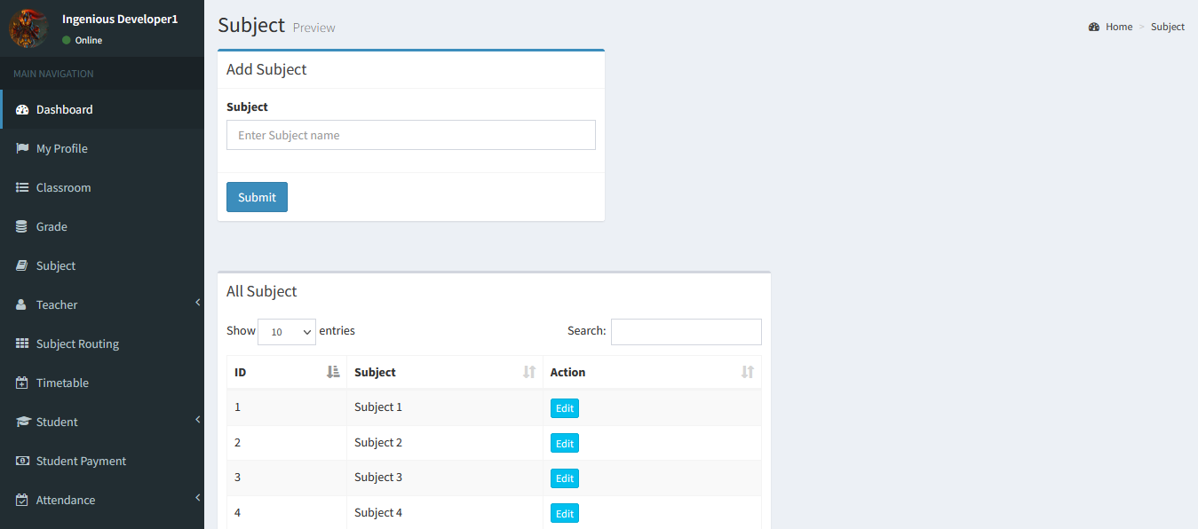
Project Module Explanation
3. SUBJECT
Subject module enables the Admin to add new subjects.
It displays the subjects that are already taught in the Organisation.
It helps us to search for particular subject.
It also enables the Admin to edit the subject

Slide 11
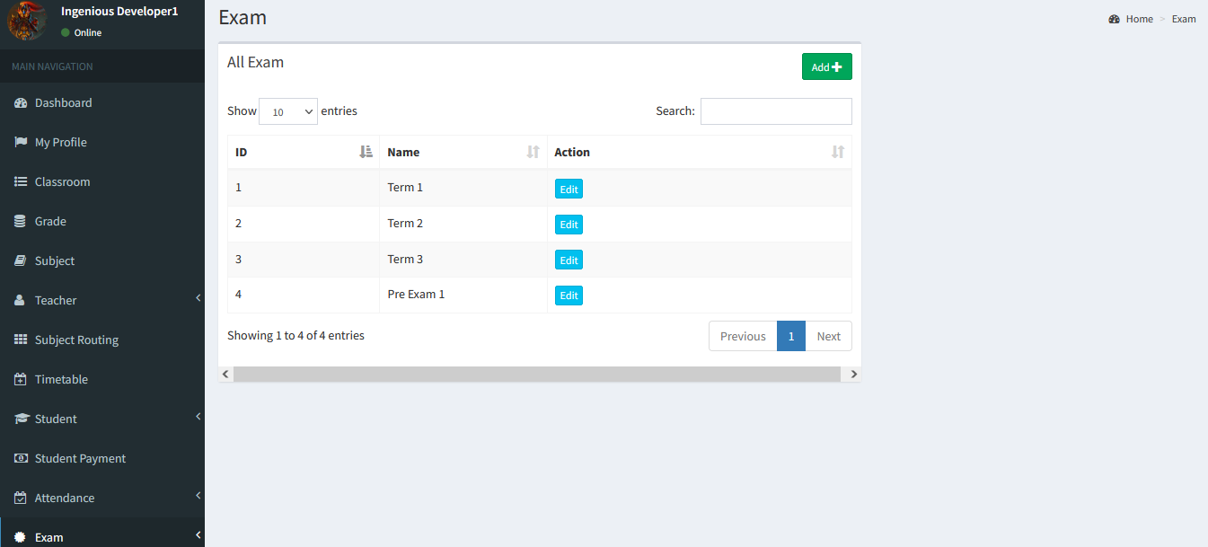
Project Module Explanation
4. EXAM
Exam module enables Admin to create the exam timetable.
It helps User to view the exam timetable.
It helps Admin as well as Teachers to record the marks obtained by the student efficiently.
It helps Admin to maintain and track all the records of student marks history.
11

Slide 12
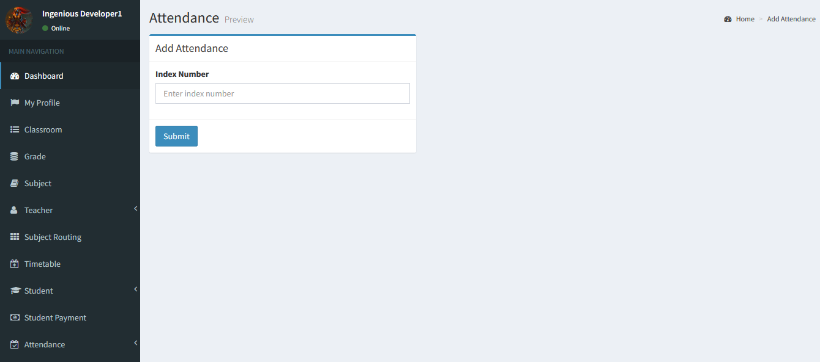
Project Module Explanation
5. ATTENDANCE
Attendance module enables User to track the attendances of Teachers and Students on daily basis.
It also maintains the records of in/out time of the Teachers and Students.
Admin can easily add the attendances using Index number(ID) of particular Teacher/Student.
12

Slide 13
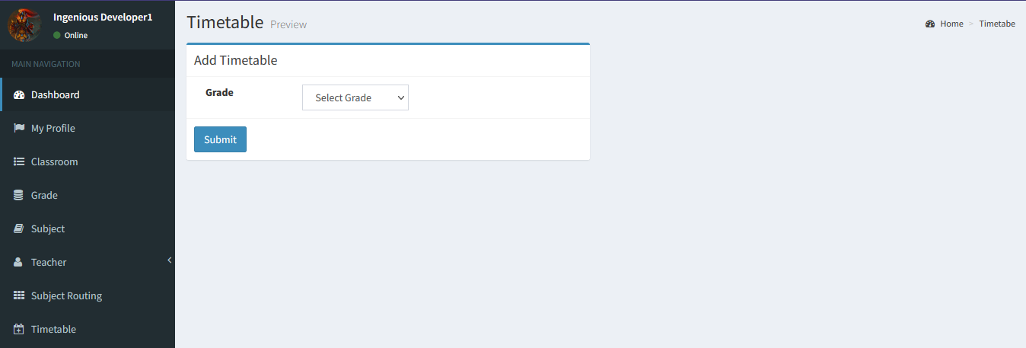
Project Module Explanation
6. TIMETABLE
Timetable module coordinates students and teachers within the classrooms and time periods of the school day.
It helps Parents and Teachers to view week’s timetable.
It enables Admin to add new timetable for particular grade students.
It enables Teachers to edit the timetable.
13

Slide 14
Functional Dependencies
TEACHER
ADMIN
PARENTS

Slide 15
Functional Dependencies
Dashboard
Subject
MY PROFILE
Exam
Timetable
Attendance

Slide 16
Project business workflow
Open ProvidenceSMS application, login as Admin, click on My Profile tab, edit profile details, click on the Teacher tab, click on Add Teacher, create Teacher account, click on Student tab, create Student account, logout.
Login as Teacher, click on My Student tab, select grade, click on submit, My Student page should be displayed, click on Edit, edit all the details, click on Update, logout.
Login as Parent, click on Timetable tab, click on My son’s Timetable, My son’s Timetable page should be displayed, click on Attendance tab, click on My son’s Attendance History, Attendance History should be displayed, click on Exam, click on My son’s Exam Marks, Exam marks should be displayed, logout.
Login as Admin, click on the Teacher tab, click on Add Teacher, create a Teacher1 account, logout as Admin. Login as Teacher1, click on My Profile, profile details should be displayed, logout as Teacher1.

Slide 17
Project business workflow
Login as Admin, click on Timetable tab, click on Add Timetable, enter the details, click on submit, logout as Admin. Login as Parent, click on Timetable tab, click on My son’s Timetable, Timetable should be displayed, logout as Parent.
Login as Admin, click on Exam tab, click on Create Exam, click on Add button, enter Exam name, click on Submit, Exam should be created, logout.
Login as Admin, click on Exam, click on Student Exam Marks, select grade and select Exam, click on submit, list of Students given the Exam should be displayed, click on Add Exam Marks, click on Submit, logout as Admin.

Slide 18
Effort & estimation
us_id | Us_name | task | Test case | Story point | mph | days
us_01 | Admin | T-01 T-02 | +-30 +-30 | 2 2 | 16 16 | 2days 2days
us_02 | Teacher | T-03 T-04 | +-30 +-30 | 2 2 | 16 16 | 2days 2days
us_03 | Parents | T-05 | +-30 | 2 | 16 | 2days
 |  |  | +-150 | 10 | 80

